Slide 1
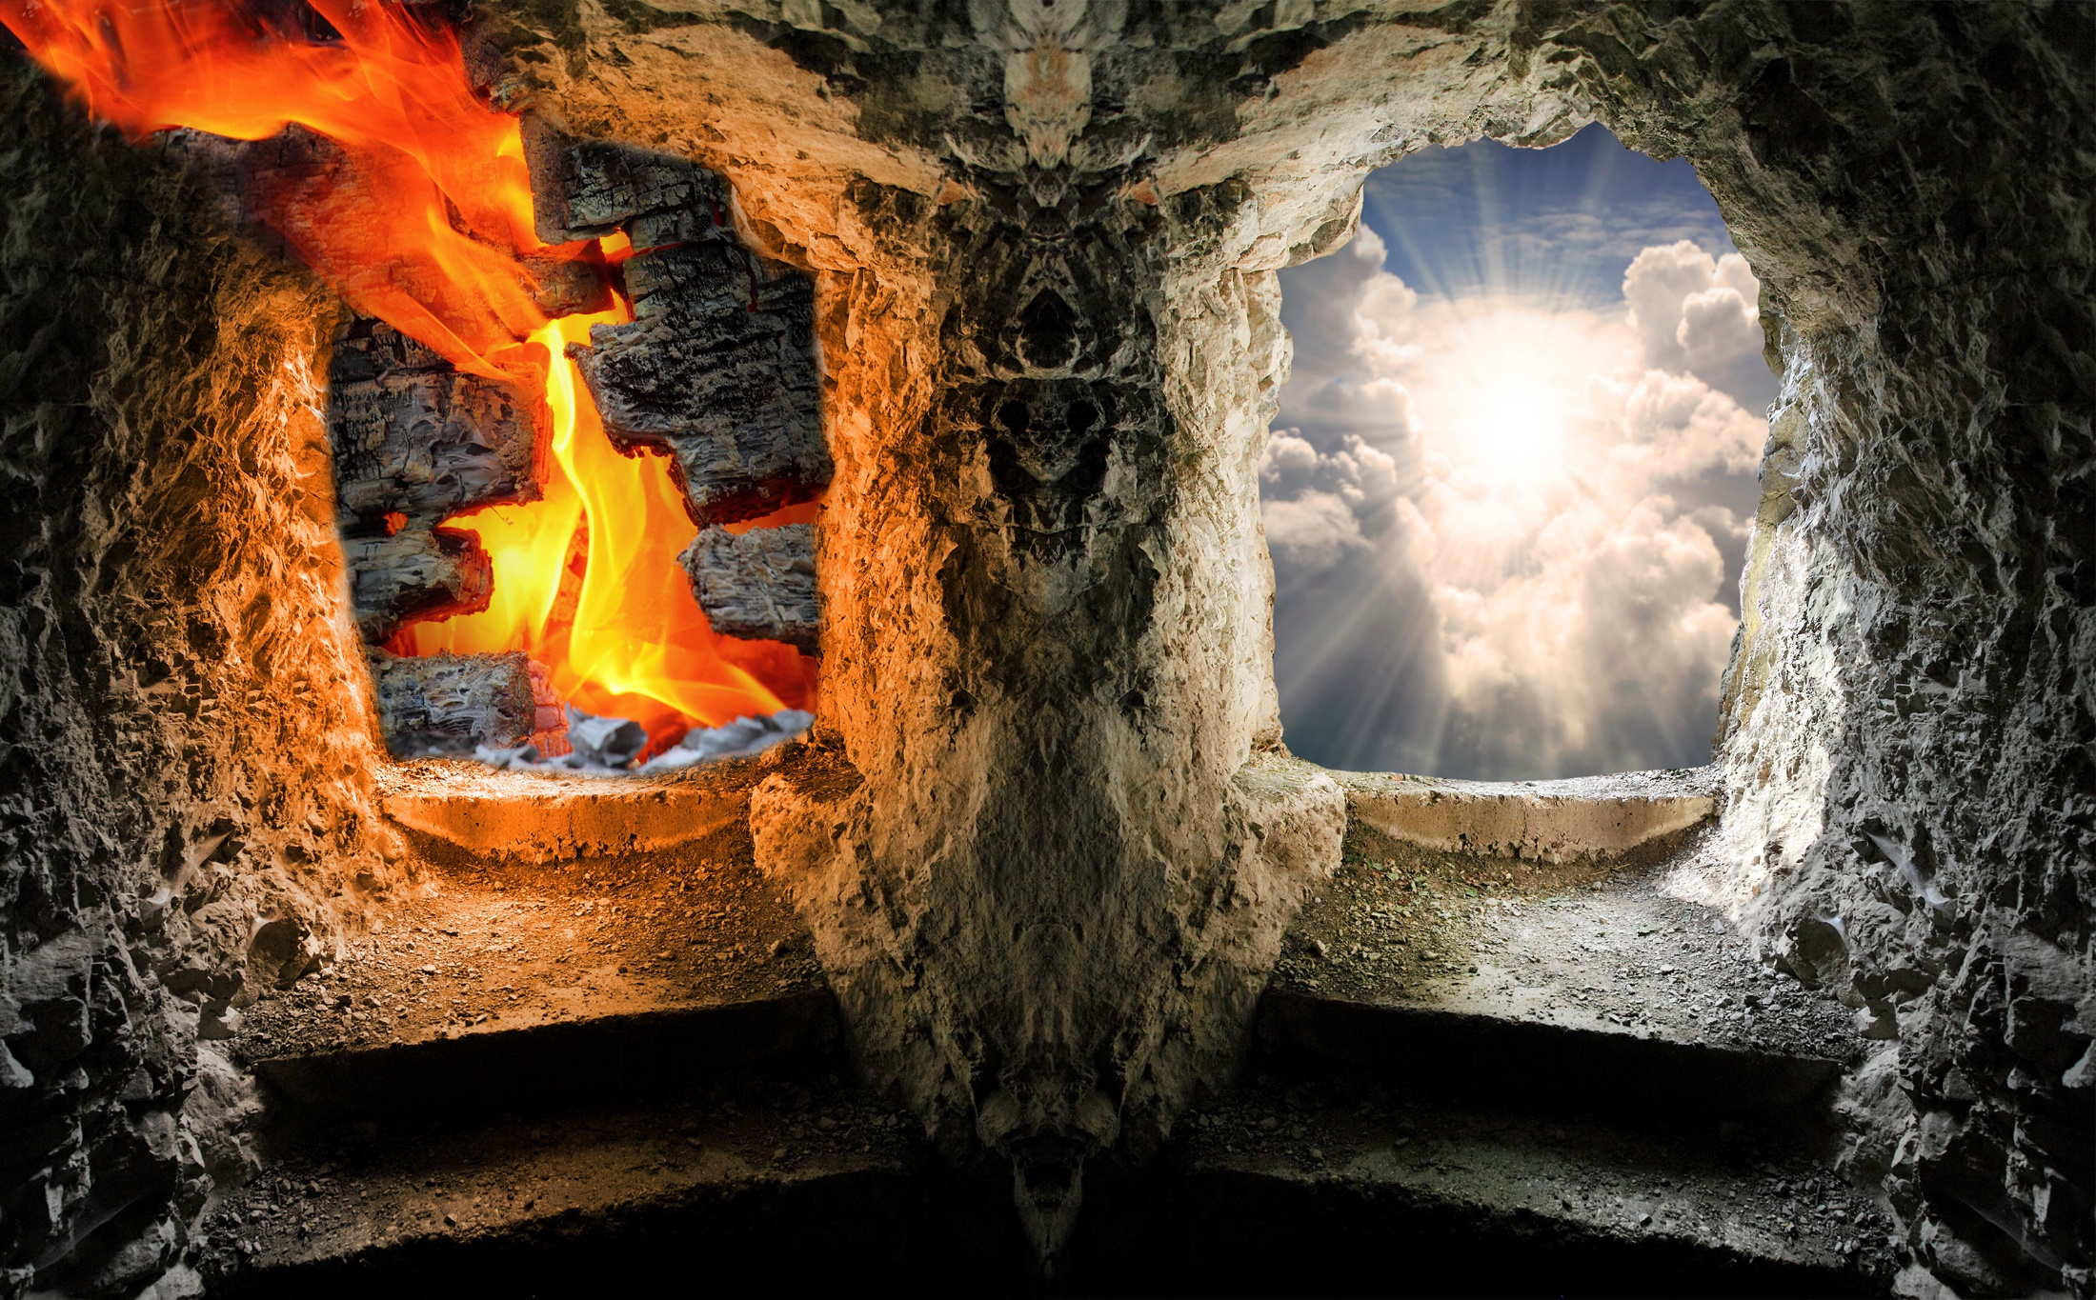
Heaven
-and-
Hell
Week 3

Slide 2

Heaven
OT word: ‘samayim’ = heaven/heavens
literally means ‘heights or high places’
So God is the God Most High… Genesis 14:18-20
“Then Melchizedek king of Salem brought out bread and wine. He was priest of God Most High and he blessed Abram, saying,
‘Blessed be Abram by God Most High,
Creator of heaven and earth.
And blessed be God Most High,
who delivered your enemies into your hands.’”

Slide 3
Heaven
NT word: ‘ouranous’ = heaven/heavens
literally means ‘that which is raised up’

Slide 4
Heaven
Heaven is a general term that is given specific
meaning by its context.
Heaven has 3 distinct meanings:
1) Atmosphere 1 Kings 21:24
“Dogs will eat those belonging to Ahab who die
in the city, and the birds of the air will feed on those who die in the country.”

Slide 5
Heaven
Heaven has 3 distinct meanings:
2) Universe / Cosmos Hebrews 11:2
“By faith we understand that the universe was formed at God’s command – so that what is seen was not made out of what was visible.”

Slide 6
Heaven
Heaven has 3 distinct meanings:
3) Dwelling Place of God Ecclesiastes 5:2
“Do not be quick with your mouth, do not be hasty in your heart to utter anything before God. God is in heaven and you are on earth,
so let your words be few.”

Slide 7
Heaven
The point of vertical imagery
(heaven being ‘up’) is this:
a) Heaven is different,
more remote from Earthly reality
b) Heaven is a higher,
more superior mode of existence

Slide 8
Heaven
Due to the fall, heaven is separated into an
‘intermediate’ and a ‘future’ heaven.
The intermediate heaven and earth
are separated from the ‘future’
heaven due to the curse.
Genesis 3:17-24

Slide 9
Heaven
Once the curse is removed
they will be compatible again
Ephesians 1:9-10
“And He made known to us the mystery of His will according to His good pleasure, which He purposed in Christ, to be put into effect when the times will have reached their fulfillment – to bring all things in heaven and on earth together under one head, even Christ.”

Slide 10
Intermediate Heaven
“But Stephen, full of the Holy Spirit, looked up to heaven and saw the glory of God, and Jesus standing at the right hand of God. ‘Look, he said, I see heaven open and the Son of Man standing at the right hand of God.’”
Acts 7:55-56
Stephen saw, not dreamed, this…

Slide 11
Intermediate Heaven
“And Elisha prayed, ‘Oh Lord, open his eyes so he may see.’ Then the Lord opened his servant’s eyes, and he looked and saw the hills full of horses and chariots of fire all around Elisha.”
2nd Kings 6:17
Remember, Acts 7 and 2nd Kings are narrative, not poetic literature.

Slide 12
Jesus’ death and
resurrection
the Fall (Genesis 3)
2nd resurrection (Rev 20:11-15)
unbelievers get bodies
“Great White Throne” judgment
1st Resurrection (Rev 20:5)
believers get bodies
Paradise taken
to heaven
Adam created
Eternity Future
Old Testament
New Testament
e
Paradise / Abe’s bosom
“Gehenna”
(eternity future)
Lake of Fire
Tartarus / lower part of Hades
Sheol or Hades
Intermediate State
Final State

Slide 13
Intermediate Heaven
What happens -right now- when we die?
“I am torn between the two: I desire to depart
and be with Christ, which is better by far;
but it is more necessary for you
that I remain in the body.”
Philippians 1:23-24

Slide 14
Intermediate Heaven
What happens -right now- when we die?
“We are confident, I say, and would prefer
to be away from the body
and at home with the Lord.”
2nd Corinthians 5:8
So, our spirits go to be with Christ,
while our bodies are in the grave,
awaiting the first resurrection.

Slide 15
Intermediate Heaven
What will we do in the intermediate heaven?
“Therefore, since we are surrounded by such a great cloud of witnesses, let us throw off everything that hinders and the sin
that so easily entangles, and let us run
with perseverance the race marked out for us.”
Hebrews 12:1
We get to encourage those who are alive.

Slide 16
What will the future Heaven be like?
God created us to rule…
Genesis 1:26
Then God said, “Let us make man in our image, in our likeness, and let them rule over the fish of the sea and the birds of the air, over the livestock, over all the earth, and over all the creatures that move along the ground…”

Slide 17
What will the future Heaven be like?
God created us to rule…
Genesis 1:28
God blessed them and said to them,
“Be fruitful and increase in number; fill the earth and subdue it. Rule over the fish of the sea and the birds of the air and over every living creature that moves on the ground.”

Slide 18
What will the future Heaven be like?
A crown speaks of ruling authority…
Revelation 2:10
“Do not be afraid of what you are about to suffer. I tell you, the devil will put some of you
in prison to test you, and you will suffer persecution for ten days. Be faithful,
even to the point of death,
and I will give you the crown of life.”

Slide 19
What will the future Heaven be like?
A crown speaks of ruling authority…
Revelation 5:9,10
“And they sang a new song; ‘You are worthy to take the scroll and to open its seals, because you were slain, and with your blood you purchased men for God from every tribe and language and people and nation. You have made them to be a kingdom and priests to serve our God, and they will reign on the earth.”

Slide 20
What will the future heaven be like?
Who will we rule over?
Cities?… Luke 19:17
“Well done, my good servant,” his master replied. “Because you have been trustworthy in a very small matter, take charge of ten cities.”

Slide 21
What will the future heaven be like?
Who will we rule over?
Angels and the ‘world’… 1st Corinthians 6:2,3
“Do you not know that the saints will judge the world? And if you are to judge the world, are you not competent to judge trivial cases?
Do you not know that we will judge angels? How much more the things of this life!”
Isaiah 9:7 ‘Everlasting’

Slide 22
Heaven
-and-
Hell

